Slide 1

A World Where it is Titanic (the movie) All Day, Everyday

Slide 2

Home Page
The home page is the heart of the operation, so to speak. It is your chance to make a first impression, but also a lasting one. We ended up spending a lot of time on the design of this page so as to really make a great impression.

Slide 3
Login
Arguably the second most important page. We wanted a simple and clean design for this form. We drew inspiration from amazon for most of the website but for this one in particular mores.

Slide 4
Create Account
After login, obviously comes create account. For how can you login without an account? Well, you obviously can because you have the info.
So, yeah. This is following the simple ideology of the other basic form pages. No need to clutter them up with the nav bar or anything like that.

Slide 5
View Profile
Once you login or create your account, you will be redirected to the home page. From their you can click on Account to see your profile.

Slide 6
Edit Profile
Once you click on Account to view your profile there is a button to edit your profile information and/or avatar.
You can also delete your account from here, should you ever want to leave us (you won’t though)…

Slide 7
Inventory
All user accounts are also seller accounts. You can buy and sell to your hearts content here at Titanic Treasures.
This is the page where you can view your inventory (the things people can buy from you).

Slide 8
Add Item
After viewing your inventory, if you discover you want to sell something else you can quickly add an item to the aforementioned inventory.

Slide 9
Edit Item
Once an item is added to your inventory, you can edit any and all attributes of said item.
This is also where you can delete items from your inventory if you so choose to do so.

Slide 10
Search the Store
Finally! Let’s talk about the most important algorithm of our website, the search algorithm.
This little gem is the easiest way to scour our millions of titanic (the movie) collectibles. Search—and filter—to your heart(of the ocean)s content.

Slide 11
View Item
Now that you have found exactly the priceless work of art you want, you can view its glorious details and decide whether or not you want to add it to your cart.

Slide 12
View Cart
Now let us look at the treasure trove you have decided to purchase today. Let the items glisten in your virtual basket and let all the world be envious at your spoils.

Slide 13
Checkout
At last, the time has come! You can now purchase all of the items in your cart and have them delivered right to your doorstep¹.

Slide 14
View Orders
Finally, you can look back upon what you have purchased previously and wonder why you ever went a day without some of these items.

Slide 15
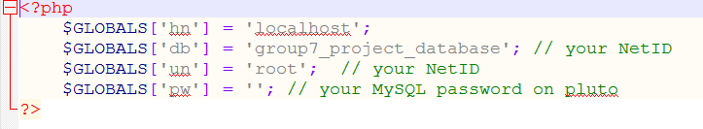
Backend – Login Helper
Generates global variables for help with database querying.

Slide 16
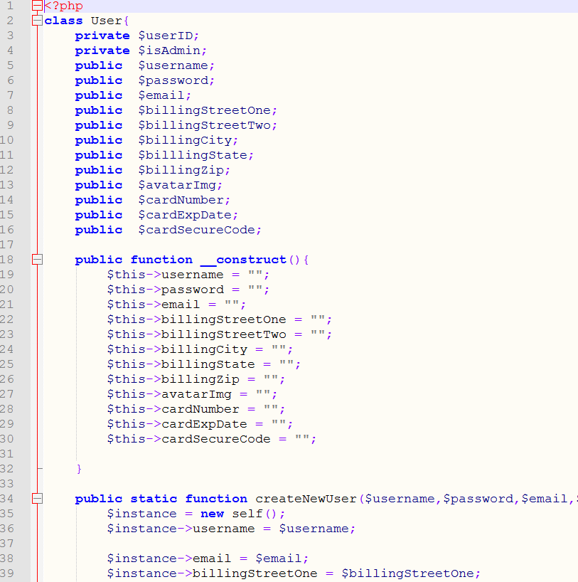
Backend – User Class
The user class employs the database by both storing local class variables with the users data (for sessions) and in the database (for security and organization).

Slide 17
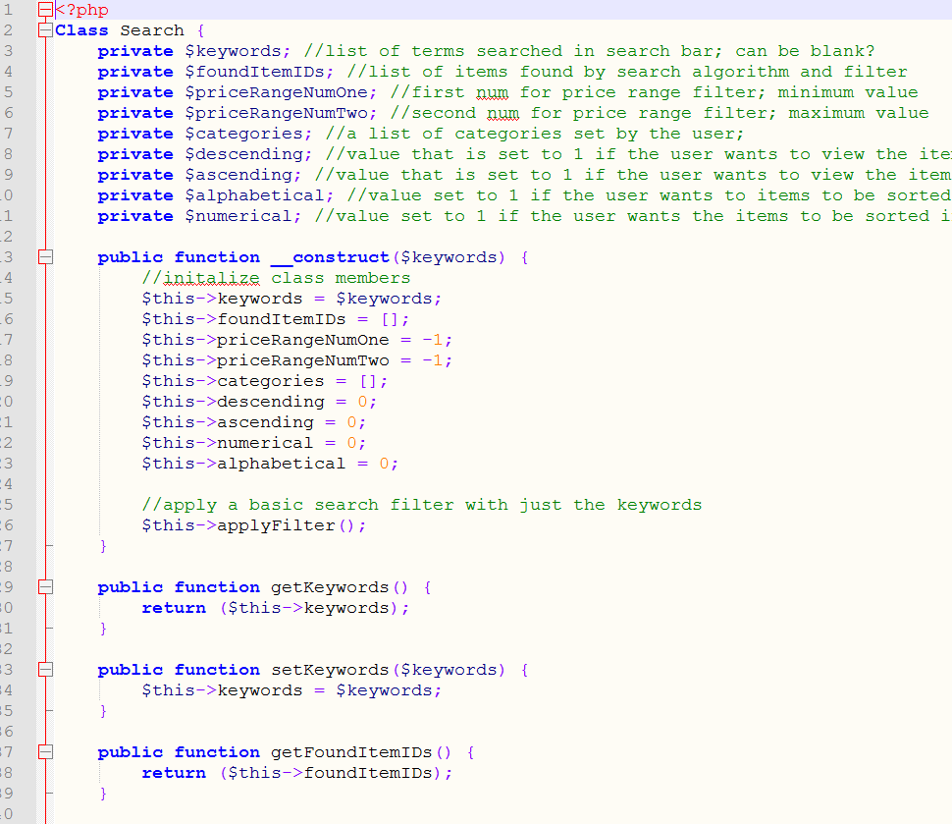
Backend – Search Class
An expertly implemented search algorithm that uses both keywords and filters to find the perfect item to fit any occasion.

Slide 18
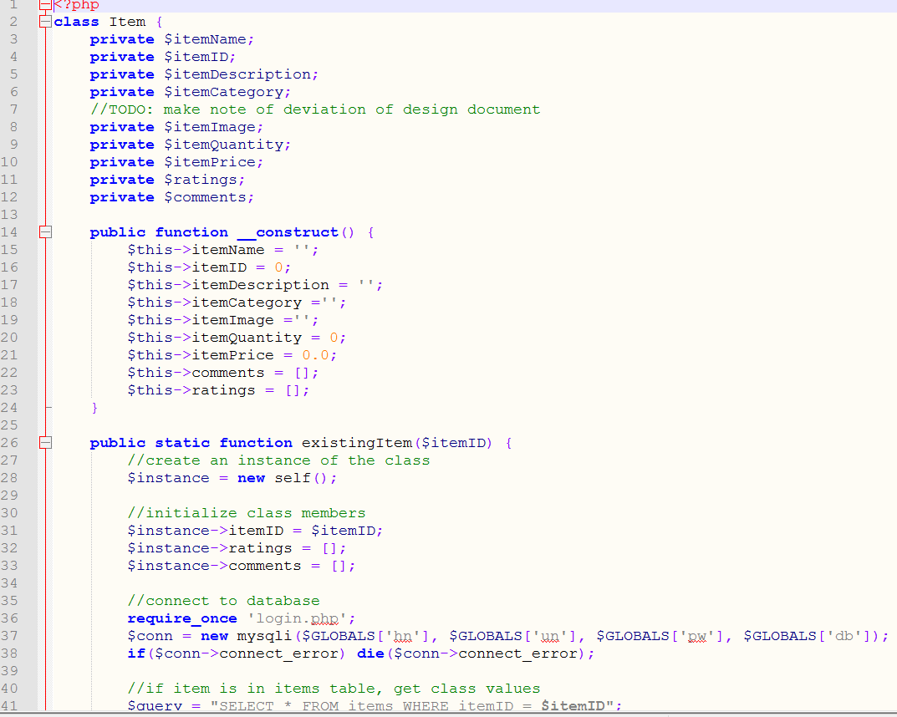
Backend – Item Class
The item class uses the database to both store the item in the database and set instantiated variables to make accessing item specific qualities easy.

Slide 19
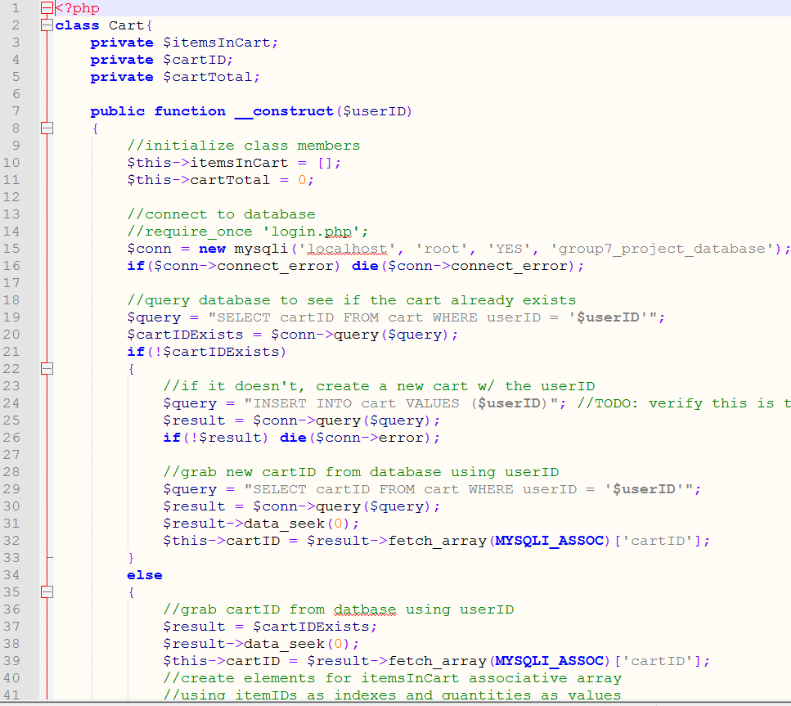
Backend – Cart Class
The cart class stores all of the users items in cart to the database and sets instantiated variables to make accessing and performing methods easier.

Slide 20
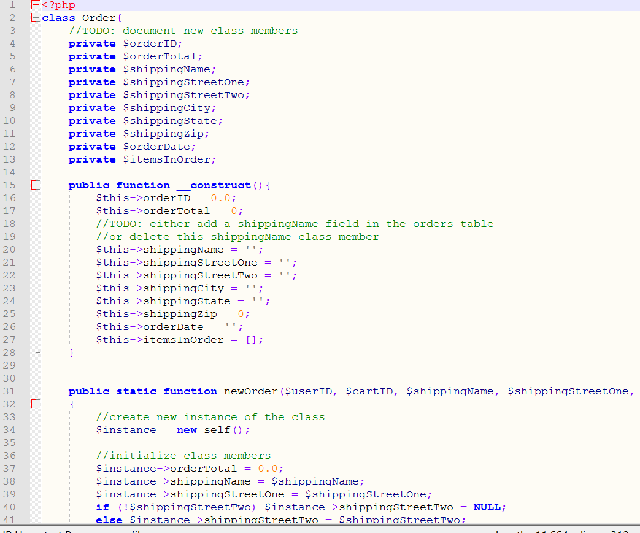
Backend – Order Class
The order class stores all of the users orders in the database and allows for methods to be used to access and display said information to the user.

Slide 21

References:
W3 Schools – super helpful
Textbook – helped with some class issues
The Power of Friendship – helped us keep calm and code on

